Slide 1
DIAGNOSIS OF ACUTE DISEASES IN VILLAGES AND SMALLER TOWNS USING AI
PIP2001 Capstone Project
Review-1
Batch Number : CAI-G14
Roll Number | Student Name
20211CAI0155 20211CAI0153 20211CAI0121 20211CAI0099 20211CAI0131 | Benakeshwar G K Vishwas Chandra C Gautham Ashwani Darshan Karthik K J Preethi N
Under the Supervision of,
Dr. MURALI PARAMESWARAN
Professor
School of Computer Science and Engineering
Presidency University
Name of the Program: B.E in Computer Science and Engineering , Specialization in Artificial Intelligence & Machine Learning
Name of the HoD: Dr. Zafar Ali Khan
Name of the Program Project Coordinator: Dr. Afroz Pasha
Name of the School Project Coordinators: Dr. Sampath A K / Dr. Abdul Khadar A / Mr. Md Ziaur Rahman

Slide 2
Introduction
Diagnosis of serious illnesses is often difficult in rural areas due to limited access to healthcare.
In these cases, timely and accurate health information is essential to ensure early diagnosis and effective treatment. A shortage of doctors in remote villages makes it difficult for residents to receive reliable diagnosis and guidance, resulting in delays in treatment and increased rates of inadequate prevention.
The project aims to create a chatbot that will provide instant help in diagnosing serious diseases based on user input. The system provides health advice by identifying symptoms and using its medical knowledge base, acting as a virtual doctor in remote areas.
It also looks to improve access to affordable diagnostic services in rural communities, thus ensuring timely treatment. The solution allows residents to better manage their health and closes the gap between them and the healthcare system.

Slide 3
Abstract
The difficult situations in healthcare in rural areas are solved by the AI system, as it quickly and accurately helps a patient with an acute disease.
The system integrates only medico knowledge database so as to make the coverage of all sorts of illnesses adequate.
It provides prescription services and home care recommendations when they require the help of a medical practitioner.
Overall this AI solution improves timely and accurate care, relieves care givers, and provides an on-demand aid for the vulnerable and under-represented groups.

Slide 4
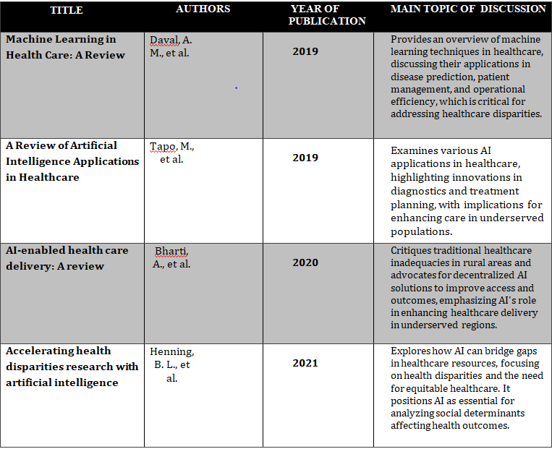
Literature Review

Slide 5
Existing method Drawback
Analization of the Lack of Regional Language Support Currently: current chatbot applications have a major disadvantage that it is not possible to use the regional language. In regions where there is a variation with local dialects, existing systems fail to provide adequate language support hence poor interaction and very limited functionality particularly where English or Hindi would not be popular. The consideration of different linguistic requirements still presents great difficulties when coming up with algorithms.
The effect of the Interaction of the user: A review of current user engagement research provides evidence that incomplete symptom and medical history data are postcode challenges within chatbot systems. By Pathak and Ansari (2021), such gaps have negative impacts on the precision of disease predictions, especially when predicting difficult or rare diseases.
Hardware Requirements: Most of the chatbot systems require the devices to be powerful enough, have enough memory and the latest software installed. However, in rural areas, the usage of gadgets is lower, and viewers often use the outdated devices, which does not meet these requirements; therefore, they have no possibility to call the chatbot services, thus can have no AI-driven healthcare.

Slide 6
Proposed Method
BACK-END
Data Processing and Knowledge Base Creation , We extract relevant medical information from the dataset, converting it into manageable text chunks. These chunks are transformed into vector embeddings using sentence-transformers and stored in a semantic index within a vector database, ensuring efficient retrieval of information.
FRONT-END
User Interaction and Response Generation , Users submit queries that are converted into query embeddings and matched against our knowledge base to retrieve ranked results. The responses are then generated using Llama2, allowing for accurate and contextually relevant answers. This approach will benefit users in villages by providing timely access to medical information and facilitating self-management of minor conditions, ultimately enhancing healthcare outcomes in underserved areas.
Tech Stack: - Python , Langchain (Framework) , Flask (Frontend) , meta llama2 (LLM) , Pinecone (Vector database)

Slide 7
Objectives
Early and accurate detection: Timely diagnosis is essential for effective treatment and reduction of problems in rural areas. AI can help diagnose symptoms in a timely manner, provide early interventions, and reduce the risk of infection, especially in cases where doctors are scarce.
Access to Affordable Healthcare: Providing affordable healthcare guarantees that economically disadvantaged groups are included. AI chatbots are bridging the gap between rural communities and primary healthcare by providing low-cost initial diagnosis and guidance.

Slide 8
Methodology/Modules
Data Extraction and Chunking: The data is processed into manageable text chunks, ensuring that each chunk adheres to the token limits of our AI model (Llama2). Overlapping chunks maintain context and improve the accuracy of subsequent analyses.
Embedding Creation and Semantic Indexing: Each text chunk is converted into vector embeddings using advanced embedding models. We create a semantic index that clusters these vectors based on their distances, allowing for efficient retrieval of relevant information during user queries.
Knowledge Base Development: Utilizing a vector database, such as Pinecone or ChromaDB, we build a robust knowledge base that stores the vector embeddings and semantic index. This enables rapid access to the most pertinent data when users submit queries regarding acute diseases.
User Query Processing: When users pose questions, these queries are transformed into embeddings and sent to the knowledge base. The system retrieves ranked results based on the proximity of the query embeddings to the stored vectors, ensuring that users receive the most relevant information.

Slide 9
Methodology/Modules
Response Generation with Llama 2: The ranked results are then processed using Llama2, our large language model. This model filters the results, interpreting both the user’s query and the context of the information retrieved, to generate accurate and contextually appropriate responses.
Patient Empowerment and Self-Management: The system also provides AI-guided advice for managing minor conditions, empowering patients to take charge of their health without frequent visits to healthcare facilities. This approach promotes self-care and alleviates pressure on local healthcare resources.

Slide 10
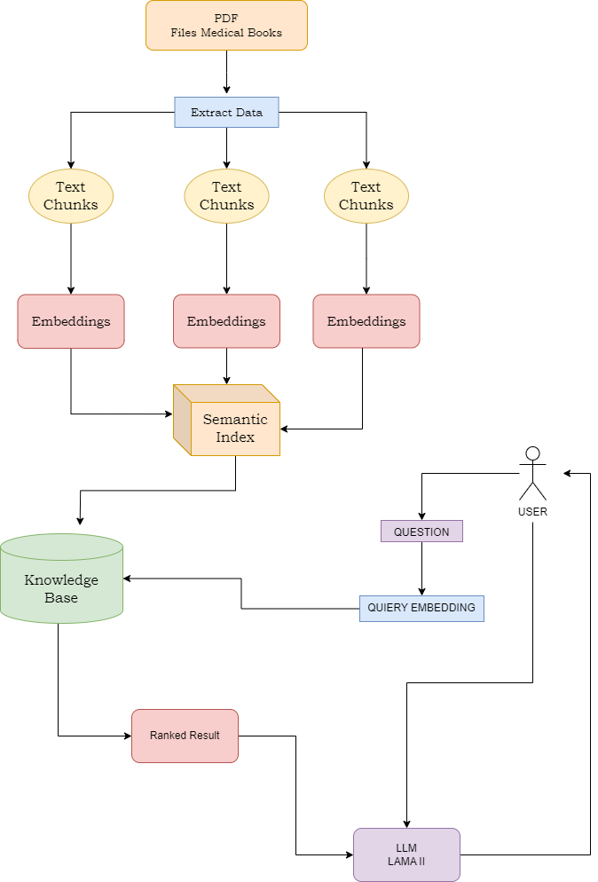
Architecture

Slide 11
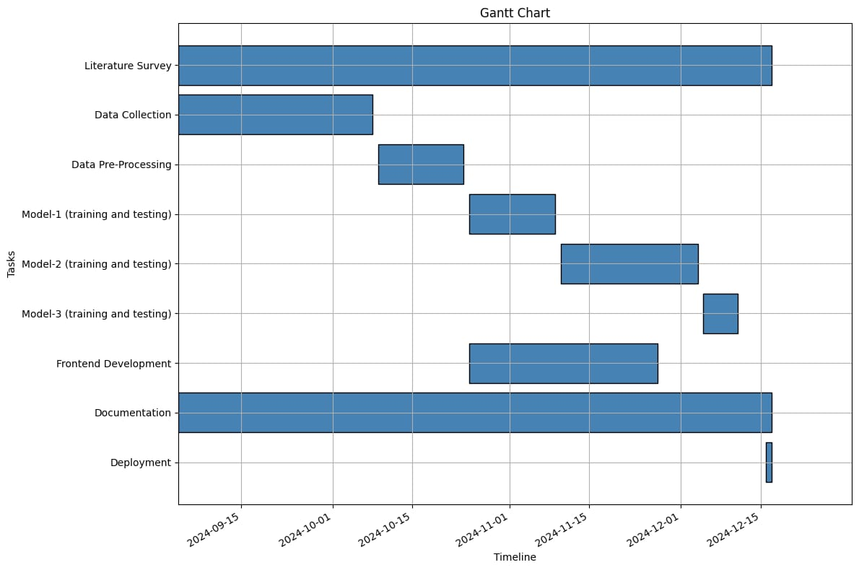
Timeline of Project

Slide 12
Expected Outcomes
Improved accessibility: The combination of information and communication technologies with remote consultancy and healthcare services will make them available to the rural populace thereby improving on their health by getting expert diagnosis and other health related solution in the shortest possible time.
Improved Health Outcomes: Early screening and prompt treatment can prevent serious illnesses, reduce mortality rates, and promote better overall health within the community. By facilitating quicker access to medical advice, the chatbot will empower individuals to take proactive steps towards their health.

Slide 13
Conclusion
The project aim’s to help improve rural healthcare through AI. The chatbot interprets symptoms mentioned and provides information on preventive measures and remedies to the user. It provides early diagnosis, easing healthcare worker burdens and offering affordable, scalable care. Future efforts will focus on refining AI models and enhancing integration with local healthcare systems.

Slide 14
Github Link
https://github.com/punyathma/A-cuteAI

Slide 15
References
Kumar Y, Koul A, Singla R, Ijaz MF. "Artificial intelligence in disease diagnosis: a systematic literature review, synthesizing framework and future research agenda." J Ambient Intell Humaniz Comput. 2023;14(7):8459-8486. doi:10.1007/s12652-021-03612-z.
Guo, Jonathan & Li, Bin. (2018). "The Application of Medical Artificial Intelligence Technology in Rural Areas of Developing Countries." Health Equity. 2:174-181. doi:10.1089/heq.2018.0037.
Pathak, Chandramaprasad and Ansari, Namrata. "Chatbot based Disease Prediction and Treatment Recommendation using AI." (May 7, 2021).
Available at SSRN: https://ssrn.com/abstract=3869072
Fan X, Chao D, Zhang Z, Wang D, Li X, Tian F. "Utilization of Self-Diagnosis Health Chatbots in Real-World Settings: Case Study." J Med Internet Res. 2021 Jan 6;23(1)
Diagnosis Of Acute Diseases In Villages And SmallerTowns Using AIMohammed Naseeruddin Taufiq, Bandaru Bhavagna Shreya, Sahil Anil Thole Chitra S, A.Mohammed A
Using AI, Diagnosis of Acute Diseases in Villages and Smaller TownsMadhu H T1, Sachin S2, Manjunath Kavishetti3 , Puneeth4 , Karthik Mahesh Gadyal5
.Chakraborty, Sanjay, Paul, Hrithik, Ghatak, Sayani, Pandey, Saroj, Kumar, Ankit, Singh, Kamred, & Shah, Mohd Asif. (2023). "An AI-Based Medical Chatbot Model for Infectious Disease Prediction." IEEE Access. PP. 1-1. doi:10.1109/ACCESS.2022.3227208.

Slide 16
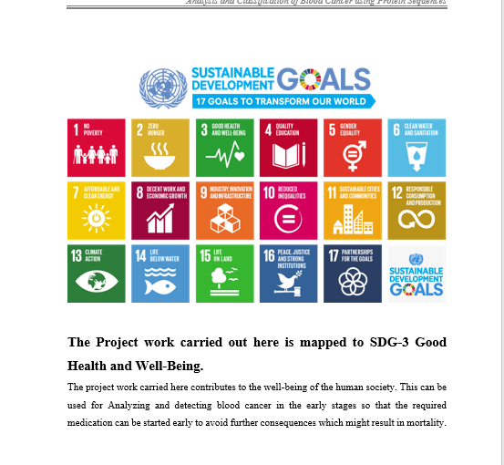
Project work mapping with SDG
SDG 1:No Poverty
The main Idea behind our project is to aid healthcare to all , without any poverty barrier.
SDG 3: Good Health and Well-Being
Promoting best possiible health diagnostics to all for everyone’s well-being.
SDG 9: Industry, Innovation, and Infrastructure
Our project , AI in medicine , hasn’t made a big market yet , making space for much more innovation and improvement in the particular Industry.
SDG 10: Reduced Inequalities
Provinding equal health facilities to all , without any barriers.
SDG 17: Partnerships for the Goals
By tying up with Non Profitable Organizations , Charitable Trusts , our project is open in looking for partnerships to fulfill our future goals.

Slide 17
Thank You

